Slide 1




Updating gopy to support Python3 and PyPy
Dong-hee Na, Chungnam National University, Daejeon, Korea
Mentors: Sebastien Binet, Alexandre Claude
13. June. 2017

Slide 2

Main topics
What is gopy?
Why Go ..?
Performance benchmark
Support CFFI backend

Slide 3
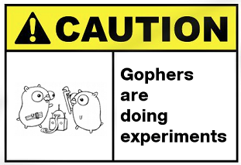
What is gopy?
gopy is heavily inspired from gomobile.
gopy is a set of packages and build tools for using Go from python interpreters.
Generates (and compiles) a Python extension module from a Go package.
( https://github.com/golang/mobile)

Slide 4
Why Go? – Software at CERN
LHC: 90% of C++ codes and a bit of Python codes for steering.
Know_The_User_Communities_Results_Summary.pdf

Slide 5
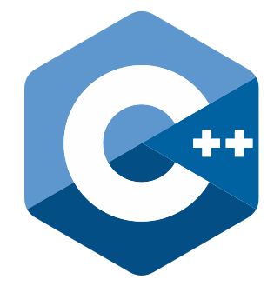

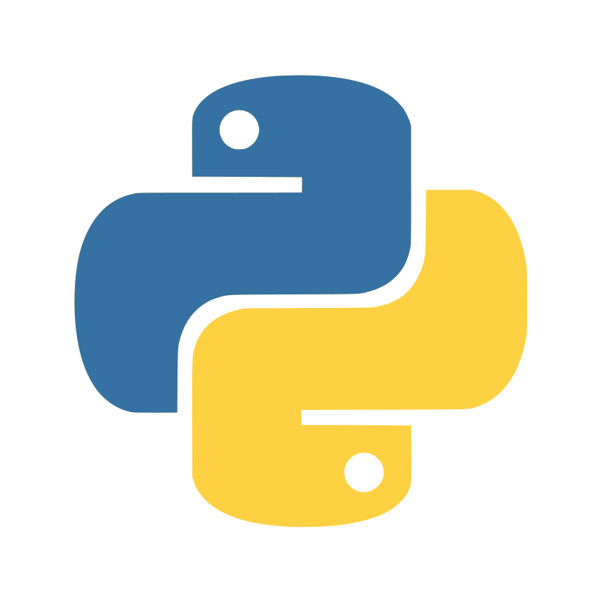
Why Go …?
Pros
Easy to install libraries with ‘go get’.
Rich standard libraries.
Built-in concurrency support
Compile fast.
Elegant and simple built-in build system.
Garbage-collected language
Error detecting is awesome.
Learning curve is low
Powerful performance.
Pros
Powerful performance
Library installation is easy
Compiled language
Learning curve is low
Useful Scientific Packages
Cons
Cons
Long long compiling times
Global Interpreter Lock
Manual memory Management
Interpreter based
Learning curve is high

Slide 6
gopy: Calculation of Pi Using the Monte Carlo Method
func monte_carlo_pi(reps int, result *int, wait *sync.WaitGroup) {
var x, y float64
count := 0
seed := rand.NewSource(time.Now().UnixNano())
random := rand.New(seed)
for i := 0; i < reps; i++ {
x = random.Float64() * 1.0
y = random.Float64() * 1.0
if num := math.Sqrt(x*x + y*y); num < 1.0 {
count++
}
}
*result = count
wait.Done()
}
func GetPI(samples int) float64 {
cores := runtime.NumCPU()
runtime.GOMAXPROCS(cores)
var wait sync.WaitGroup
counts := make([]int, cores)
wait.Add(cores)
for i := 0; i < cores; i++ {
go monte_carlo_pi(samples/cores, &counts[i], &wait)
}
wait.Wait()
total := 0
for i := 0; i < cores; i++ {
total += counts[i]
}
pi := (float64(total) / float64(samples)) * 4
return pi
}
http://tstra.us/code/goPi/

Slide 7
gopy vs Python: Calculation of Pi Using the Monte Carlo Method
gopy is very easy to install.
Using a go get is all you have to do!
$> go get -u -v github.com/go-python/gopy github.com/go-python/gopy (download) github.com/gonuts/commander (download) github.com/gonuts/flag (download) github.com/gonuts/flag github.com/go-python/gopy/bind github.com/gonuts/commander github.com/go-python/gopy

Slide 8
gopy vs Python: Calculation of Pi Using the Monte Carlo Method
def monte_carlo_pi_part(n):
count = 0
for i in range(int(n)):
x=random.random()
y=random.random()
# if it is within the unit circle
if x*x + y*y <= 1:
count=count+1
#return
return count
def GetPI(n):
np = multiprocessing.cpu_count()
part_count=[n/np for i in range(np)]
pool = Pool(processes=np)
count=pool.map(monte_carlo_pi_part, part_count)
return sum(count)/(n*1.0)*4
if __name__ == '__main__':
n = 100000
py_start = time.time()
result = GetPI(n)
py_end = time.time()
print("Python result: %f time_elapsed: %f" % (result, py_end-py_start))
go_start = time.time()
result = calculatePi.GetPI(n)
go_end = time.time()
print("gopy result: %f time_elapsed: %f" %(result, go_end-go_start))
https://gist.github.com/amitsaha/2036026

Slide 9
gopy vs Python: Calculation of Pi Using the Monte Carlo Method
gopy helps to use Go’s useful features on the Python interpreter.
End-user can easily run Go codes on the Python interpreter.
root@180a6474ebba:~/test# gopy bind github.com/go-python/gopy/_examples/calculatePi
2017/06/11 06:03:21 work: /tmp/gopy-546154656
root@180a6474ebba:~/test# python
Python 2.7.12 (default, Nov 19 2016, 06:48:10)
[GCC 5.4.0 20160609] on linux2
Type "help", "copyright", "credits" or "license" for more information.
>>> import calculatePi
>>> calculatePi.GetPI(10000)
3.1564
root@180a6474ebba:~/test# python pi_mp.py
n: 100000
Python result: 3.145880 time_elapsed: 0.030254
gopy result: 3.137400 time_elapsed: 0.002960 ← Much Faster!!!

Slide 10
gopy: Limitation
gopy does not supports CPython3 nor PyPy.
Many go’s implementations/features are not yet implemented in gopy
root@180a6474ebba:~/test# pypy pi_mp.py
Traceback (most recent call last):
File "pi_mp.py", line 12, in <module>
import calculatePi
ImportError: No module named calculatePi
root@180a6474ebba:~/test# python3
Python 3.5.2 (default, Nov 17 2016, 17:05:23)
[GCC 5.4.0 20160609] on linux
Type "help", "copyright", "credits" or "license" for more information.
>>> import calculatePi
Traceback (most recent call last):
File "<stdin>", line 1, in <module>
ImportError: dynamic module does not define module export function (PyInit_calculatePi)

Slide 11
GSoC Project: Support Python3 and PyPy
Need to support Py2/3 and PyPy.
PyPy’s implementation is not strictly 100% compatible with Ctypes.
CFFI is a good choice to support various python compilers.
CFFI interacts with almost any C code from Python.
root@180a6474ebba:~/test# gopy bind --lang=cffi github.com/go-python/gopy/_examples/calculatePi
2017/06/11 06:06:46 work: /tmp/gopy-214312004
root@180a6474ebba:~/test# python pi_mp.py
n: 100000
Python result: 3.135280 time_elapsed: 0.024898
gopy result: 3.143200 time_elapsed: 0.006861 ← Much Faster!!!
root@180a6474ebba:~/test# pypy pi_mp.py
n: 100000
Python result: 3.147240 time_elapsed: 0.023687
gopy result: 3.145040 time_elapsed: 0.017225 ← Much Faster!!!
root@180a6474ebba:~/test# python3 pi_mp.py
Python result: 3.136560 time_elapsed: 0.037512
gopy result: 3.143920 time_elapsed: 0.003738 <- Much Faster

Slide 12
GSoC Project: Support Python3 and PyPy
Inspects a Go package
Extracts the exported types, funcs, vars and consts
Creates a Go package that cgo exports the exported entities
Designates which interface should be exported to CFFI.
ffi.cdef("""
typedef signed char GoInt8;
typedef unsigned char GoUint8;
.
.
.
extern void cgo_pkg_calculatePi_init();
extern GoFloat64 cgo_func_calculatePi_GetPI(GoInt p0);
""")

Slide 13
GSoC Project: Support Python3 and PyPy
Inspects a Go package
Extracts the exported types, funcs, vars and consts
Creates a Go package that cgo exports the exported entities
Designates which interface should be exported to CFFI.
Creates a wrapping codes for CFFI by Python.
# pythonization of: calculatePi.GetPI
def GetPI(samples):
c_samples = _cffi_helper.cffi_cnv_py2c_int(samples)
cret = _cffi_helper.lib.cgo_func_calculatePi_GetPI(c_samples)
ret = _cffi_helper.cffi_cnv_c2py_float64(cret)
return ret

Slide 14
GSoC Project: Support Python3 and PyPy

Slide 15
GSoC Project: Support Python3 and PyPy

Slide 16
GSoC Project: Support Python3 and PyPy

Slide 17
GSoC Project: Project Plan
Migrate into CFFI library to gencffi*.go for current implementation.
Implement wrapping of functions with builtin arguments.
Implement wrapping of functions with slices/arrays of builtin arguments.
Implement wrapping of functions with user types.
Detect functions returning a Go error and make them pythonic (raising an Exception).
Implement wrapping of user types / Go maps / Go interfaces.
Write documents for English and Korean.

Slide 18
GSoC Project: Goal
Able to use Go’s awesome features on Python 2/3 and PyPy.

Slide 19
Newcomers are always welcomed
https://github.com/go-python/gopy
https://groups.google.com/forum/#!forum/go-python
https://gophers.slack.com/messages/go-python

Slide 20
Thank you
donghee.na92@gmail.com

